Slide 1

Interactive Traffic System
Author(s):
Manuel Mane Penton
Nayib Ega
Balewa Glenn
December 16, 2019
Telecommunications Technology Engineering
TCET 4282
Prof. Hossain

Slide 2
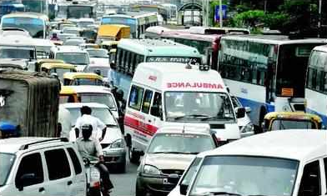
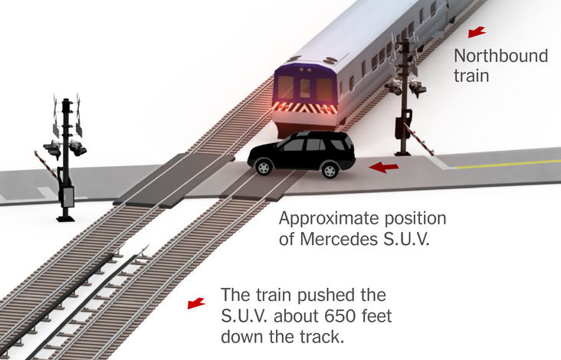
Problem to be solved
New York city is the third most congested city in the world and the 2nd worst traffic-jammed city in United States.
New York drivers spend 13% of their time sitting in congestion as average.
It is expected that traffic congestion will cost to the city $100 billion over the next five years.
Traffic congestion is the main cause for emergency response time to increase.
Accidents on train crossroads increased in a 40% in the period 2016-2019

Slide 3
Objectives - Proposed Solution
Development of a street rail system able to read real-time traffic conditions and make adjustments to alleviate congestion.
Development of a first responder interface to overwrite street rail system.
Development of a train-crossroad system that includes an emergency module for obstacles in the crossroad.

Slide 4
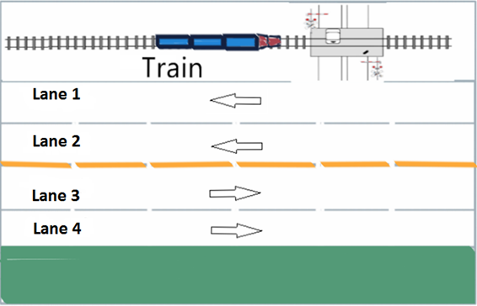
Proposed Architecture

Slide 5
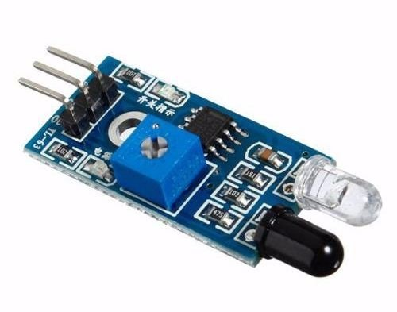
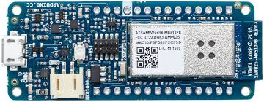
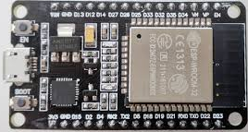
Required Materials
7 IR sensors
2 Arduino MKR1000
ESP32 Arduino

Slide 6
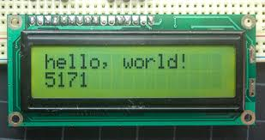
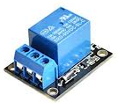
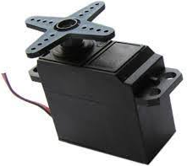
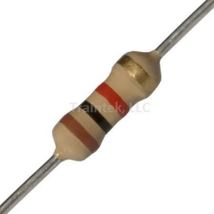
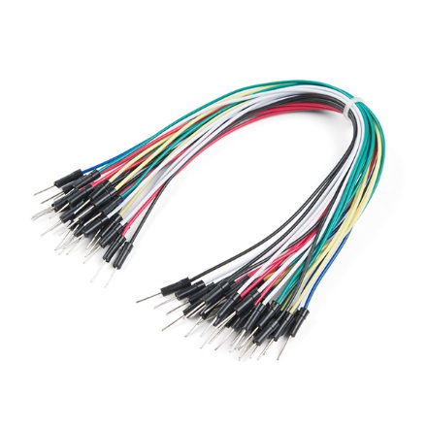
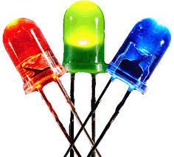
Required Materials
4 LCDs
2 Servo motors
3 relays
3 Other connectors

Slide 7
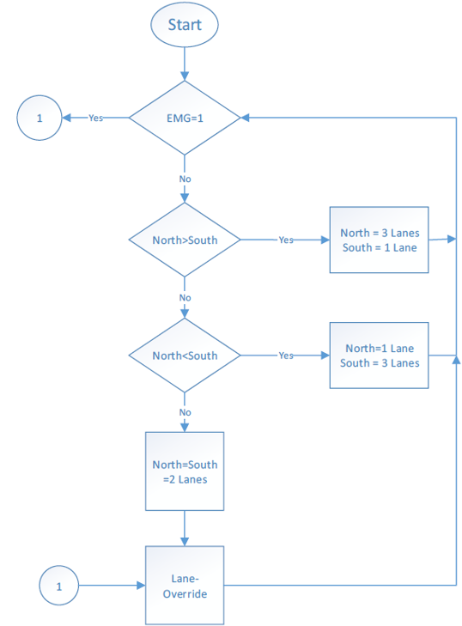
FlowChart
Street Rail Module

Slide 8
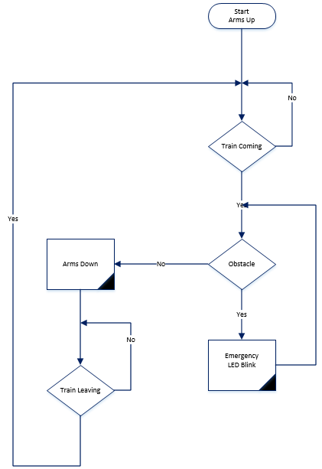
FlowChart
Cross - Road Module

Slide 9
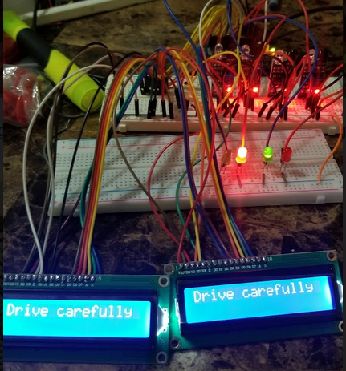
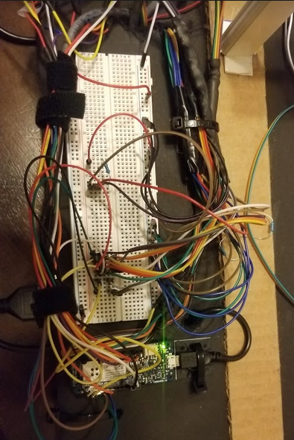
Street Rail Module
MKR 1000 Connections
Functions:
Read IR sensors: Create counter from the traffic on each rail of the street.
Send counter readings, using wireless communication, to the ESP32.
Receive message, via wireless communication, from ESP32 and deploy rails, LEDs and LCDs message according to received message indications.
2 LCDs
4 IR sensors
4 LEDs
Jumper Wires

Slide 10
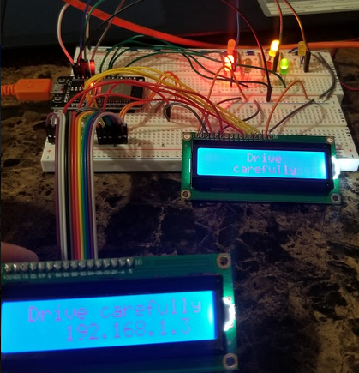
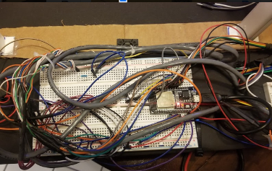
Street Rail Module
ESP 32 Connections
Functions:
Manage/read web server inputs to:
Update LEDs and LCD’s message.
Send message to MKR1000 to update LEDs, LCD’s message and street rails.
Process received readings of the rail counters, from the MKR 1000 to:
Update LEDs and LCD’s message.
Send message to MKR1000 to update LEDs, LCD’s message and street rails.
2 LCDs
4 LEDs
3 Rails
Jumper Wires

Slide 11
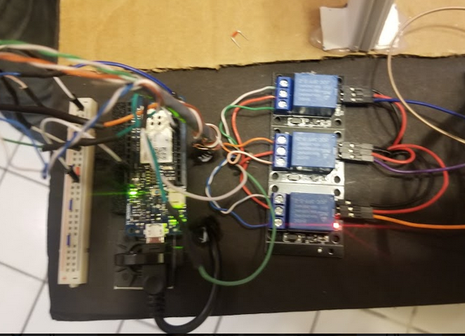
Cross Rail Module
MKR 1000 Connections
Functions:
Read IR sensors from the train rail.
Control motor server for traffic control when train approaches.
Activate emergency LED when an obstacle is on the road and train is approaching
2 servo motors
3 IR sensors
LED

Slide 12
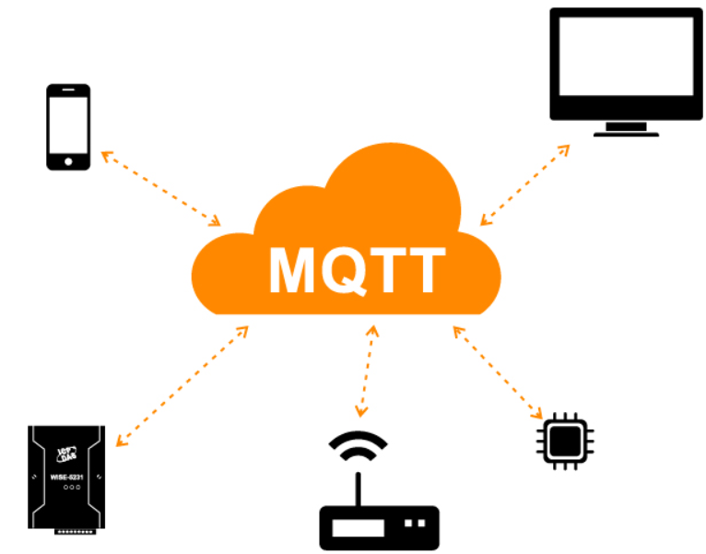

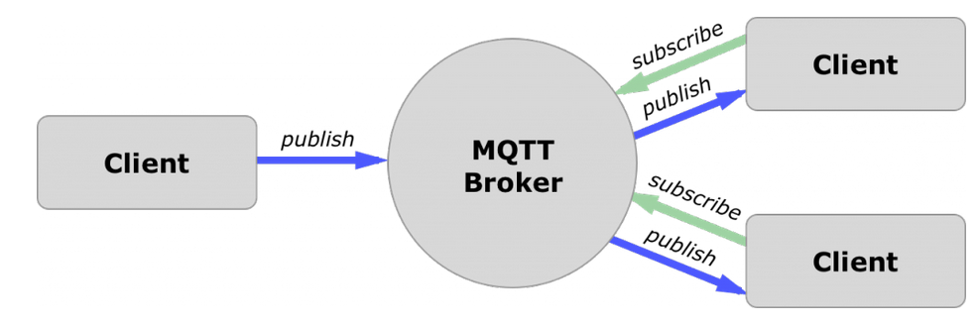
MQTT Protocol
Used for the wireless communication among the arduino boards (MKR1000 and ESP32):
MQTT: Message Queuing Telemetry Transport. It transports messages between devices
Lightweight publish/subscribe messaging protocol designed for M2M telemetry: low network usage, low power usage, real-time.

Slide 13
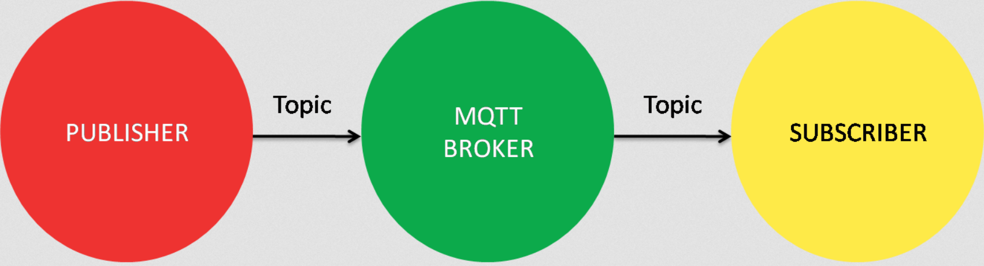
MQTT Protocol
Broker (Laptop)
IP Address
ESP 32:
Publish topic:
Southside
Subscribe topics:
Sensor 1
Sensor 2
Sensor 3
Sensor 4
MKR 1000:
Publish topics:
Sensor 1
Sensor 2
Sensor 3
Sensor 4
Subscribe topic:
southside

Slide 14
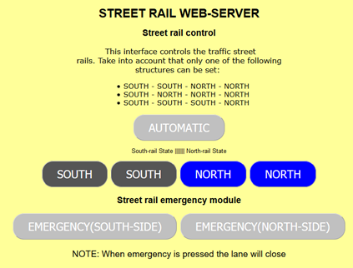
WEB SERVER
Function:
Automatic/Manual mode:
Automatic mode: Street rails modify according to the IR sensor readings.
Manual mode: Street rails are modified from the Web Server’s buttons
Emergency buttons are used for emergency services to close the rail (it overwrites the automatic and manual modes).

Slide 15
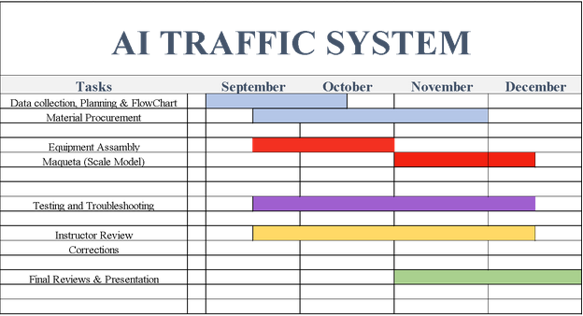
Project Timeline

Slide 16
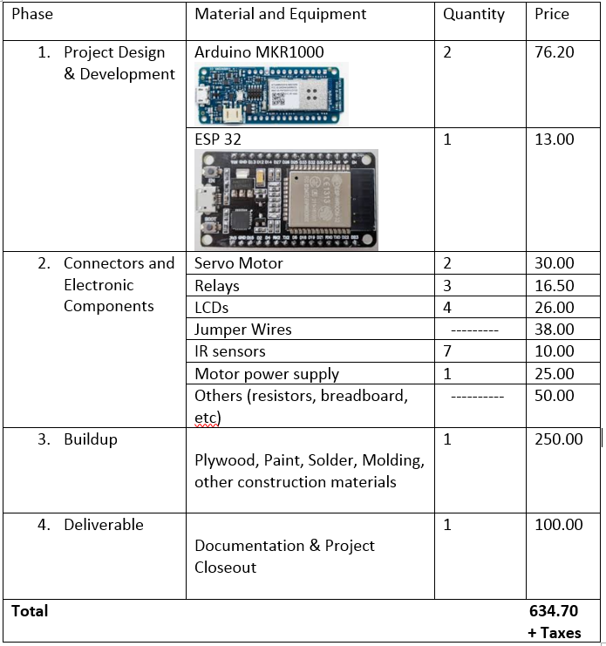
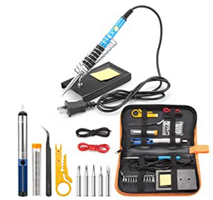
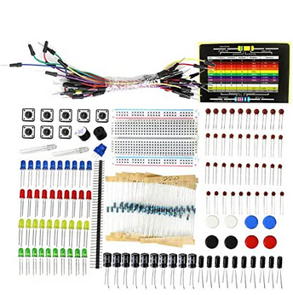
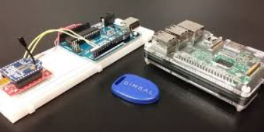
Project Budget

Slide 17
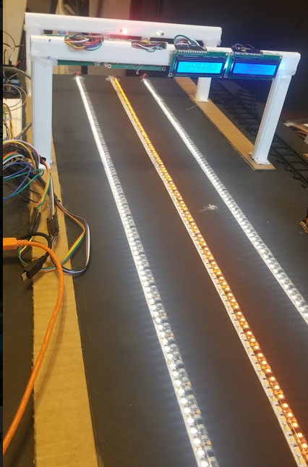
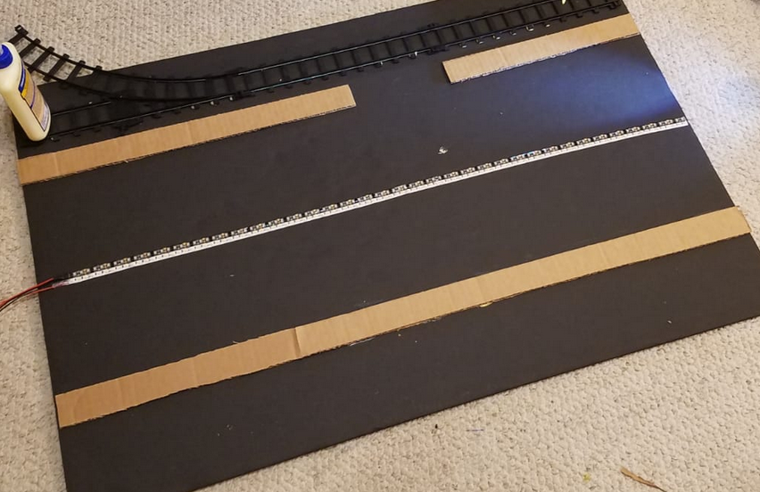
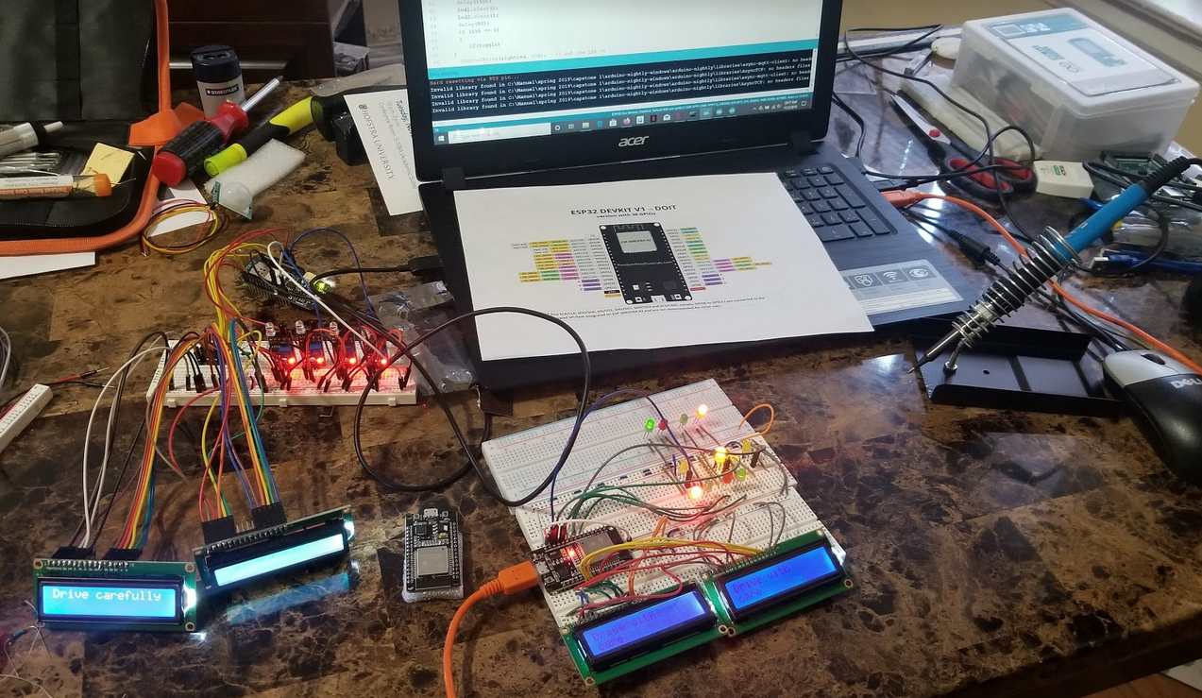
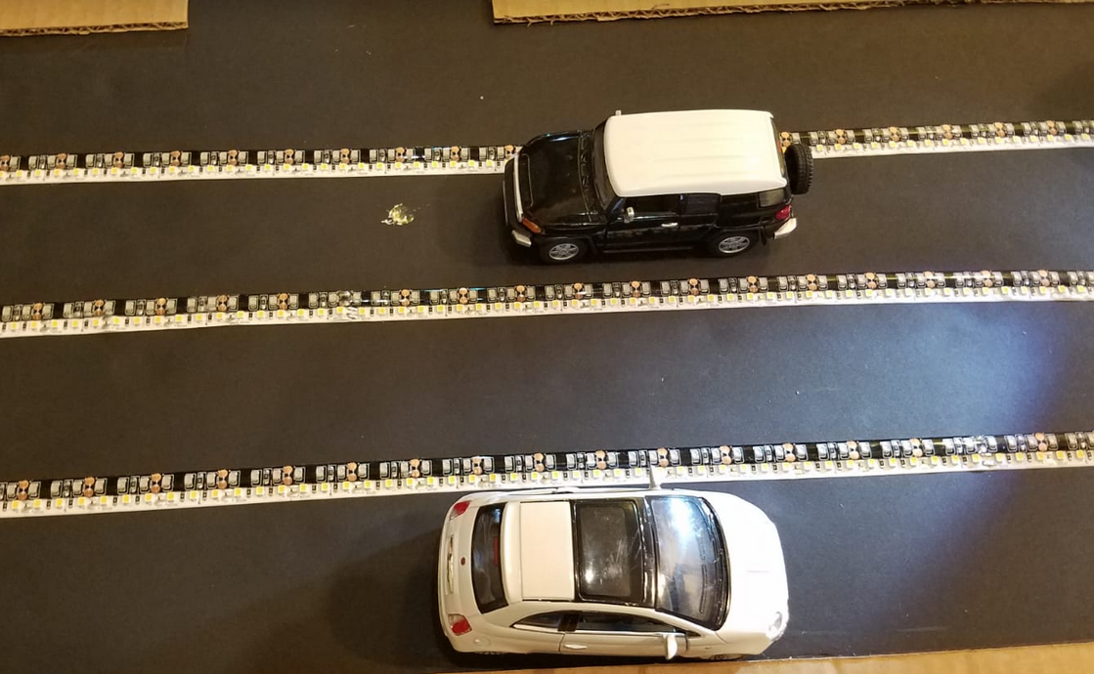
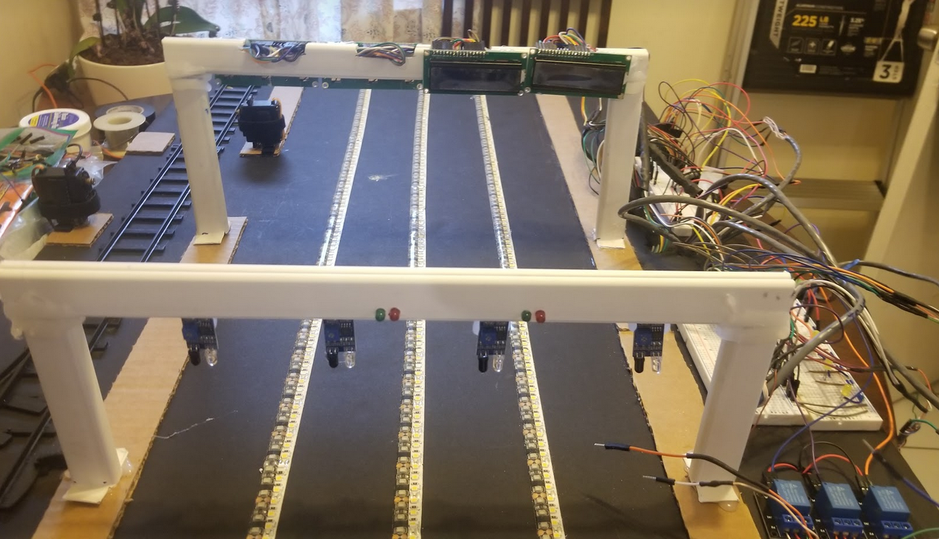
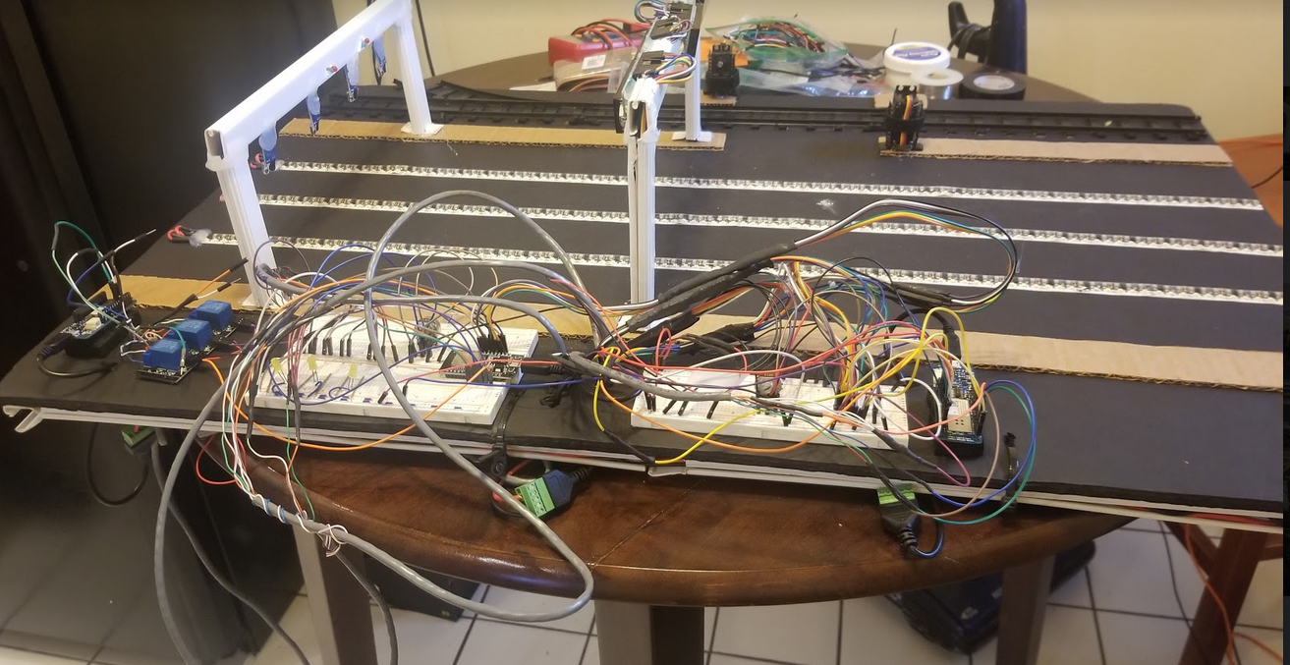
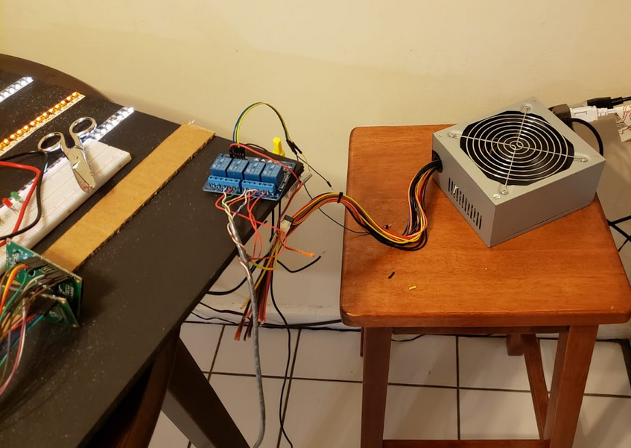
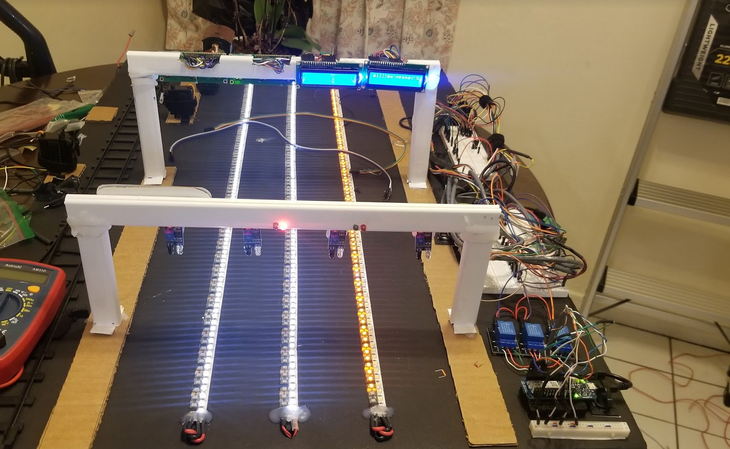
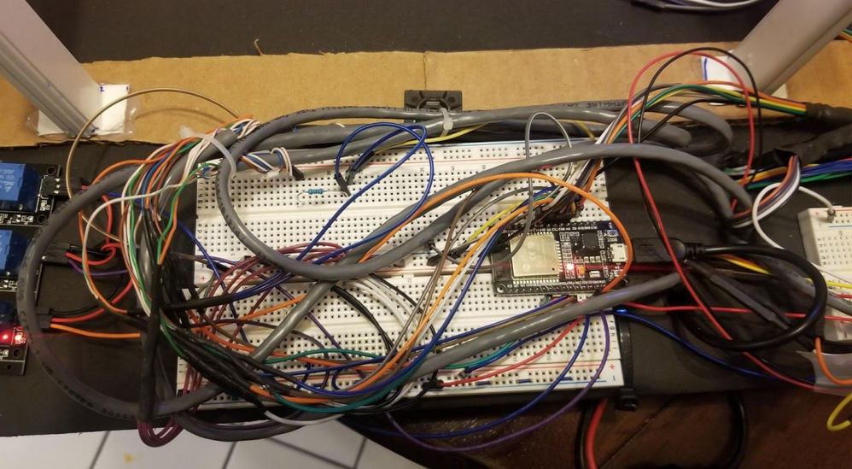
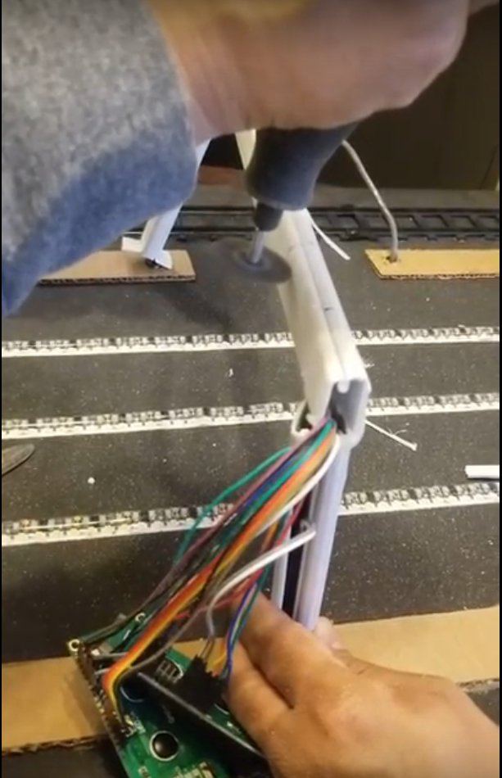
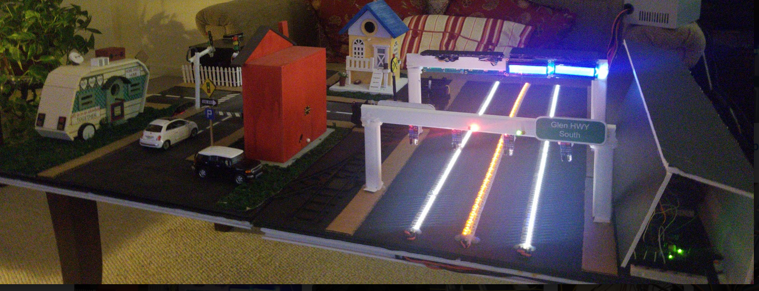
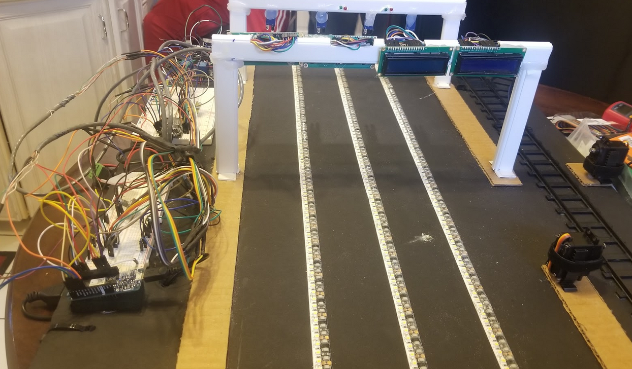
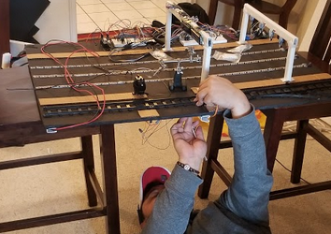
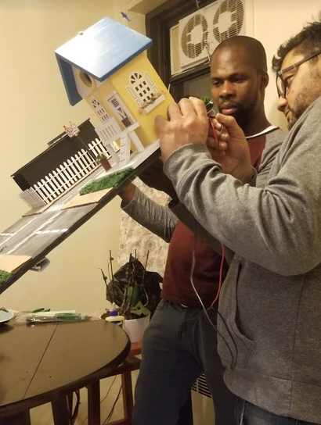
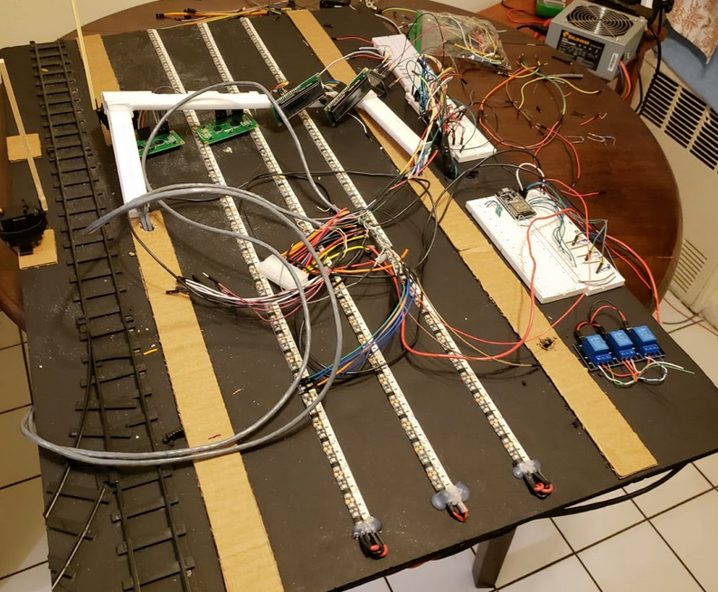
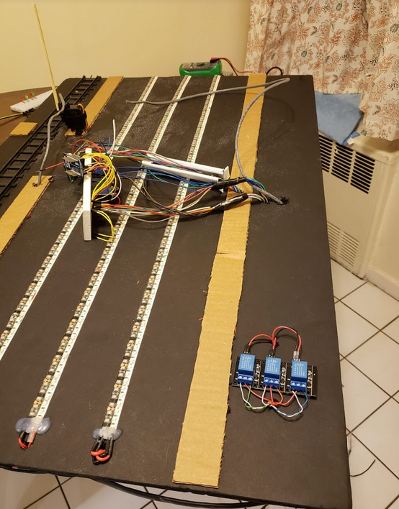
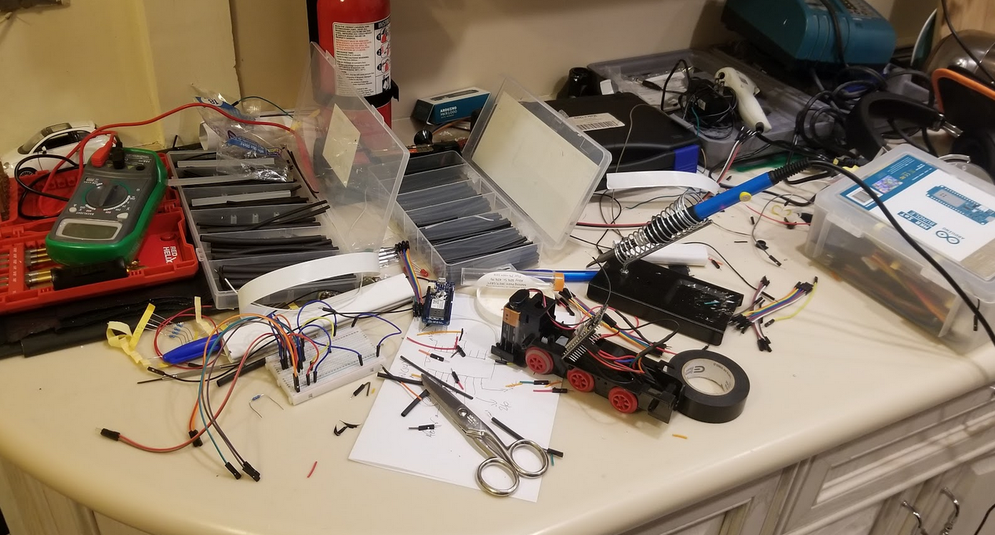
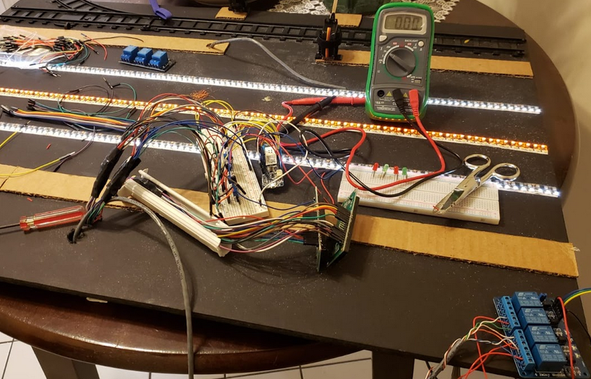
Board Building Process

Slide 18
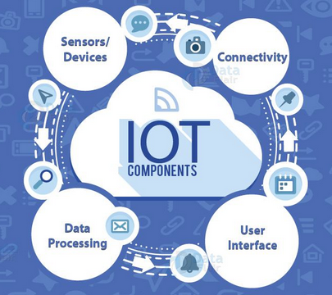
Conclusions
Interactive Traffic System project proposes an IoT system addressed to solve one of the common problems in current society such as traffic congestion. Using arduino platforms and some of the principles of IoT engineering such as wireless communication and web-based system, our project embraced a conjunction of different technologies and principles such as:
WiFi connection
MQTT protocol for M2M communication
Web-based application
Arduino Platforms
NodeMcu Arduino Platform
Connection of Electronic Components
Arduino C programming
In addition, we can say that a very basics of AI principle was also used since our components learn from changing conditions and behaviors. Based on these information, the platform make decision to alleviate congestion and to prevent accidents.

Slide 19




